Slide 1
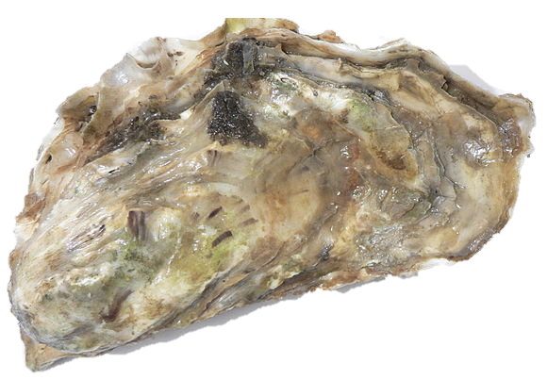

The genetic legacy of the deliberate introduction of Pacific oysters
Erik Sotka
Allan Strand
Ryan Carnegie, Jim Carlton, Lucia Couceiro, Jeff Crooks, Hikaru Endo, Hilary Heyford, Masakazu Hori, Mits Kamiya, Gen Kanaya, Judith Kochmann, Kun-Seop Lee, Lauren Lees, Hannah Miller, Massa Nakaoka, Eric Pante, Jennifer Ruesink, Evangelina Schwindt, Åsa Strand, Richard Taylor, Ryuta Terada, Martin Thiel, Takefumi Yorisue, Danielle Zacherl

Slide 2
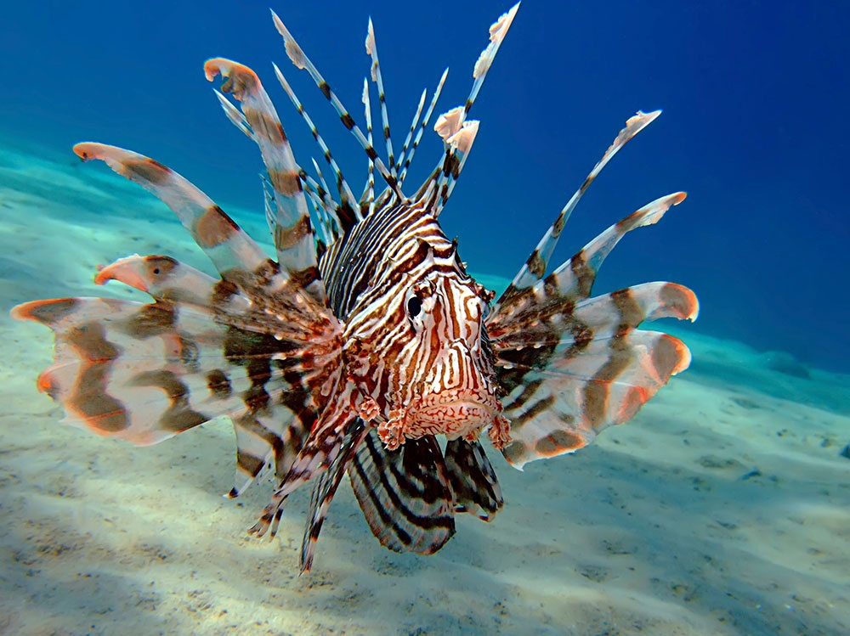
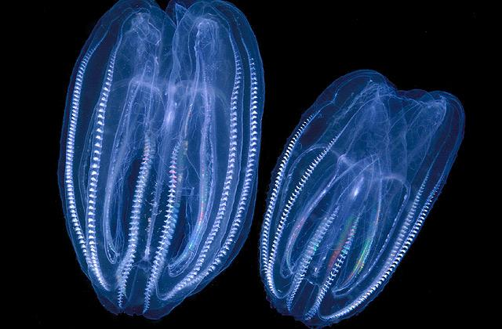
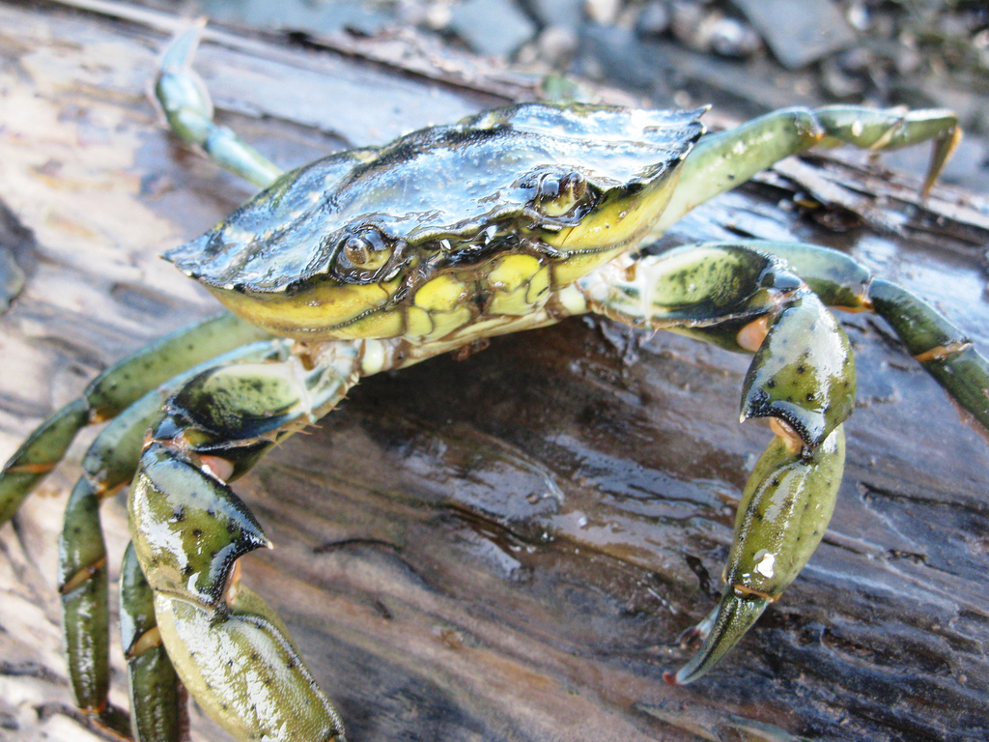
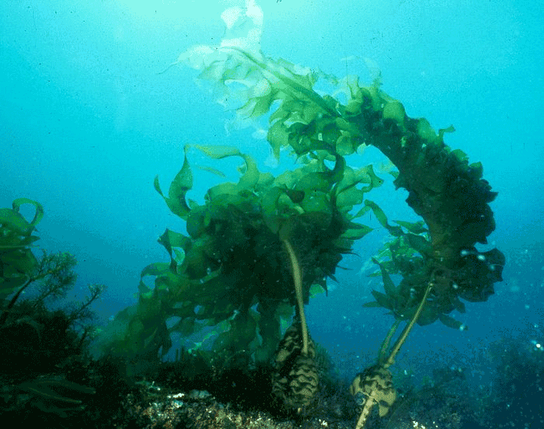
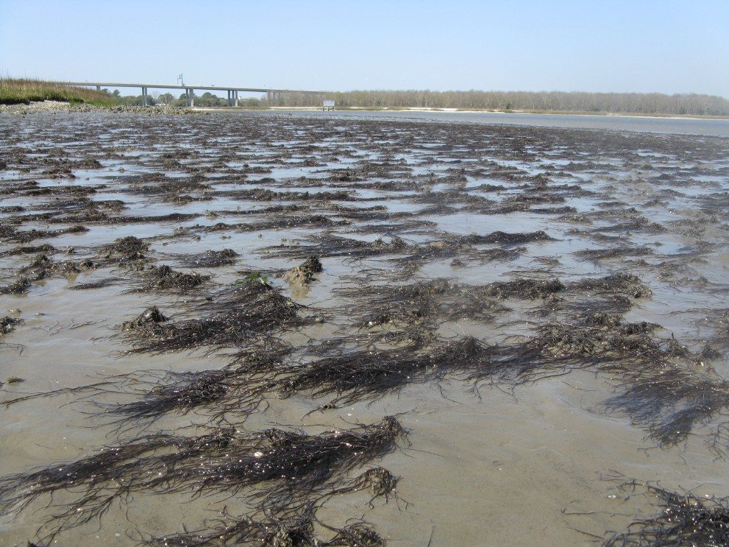
Notes:
the pace and impacts of non-native marine species continues to grow worldwide. new pools of species are now available because of accelerating pace of commerce and trade worldwide, unleashing even more species to move awayfrom their native ranges.
Lionfish
European green crab
Borea (cenophore)
Undaria, a japanese kelp.

Slide 3
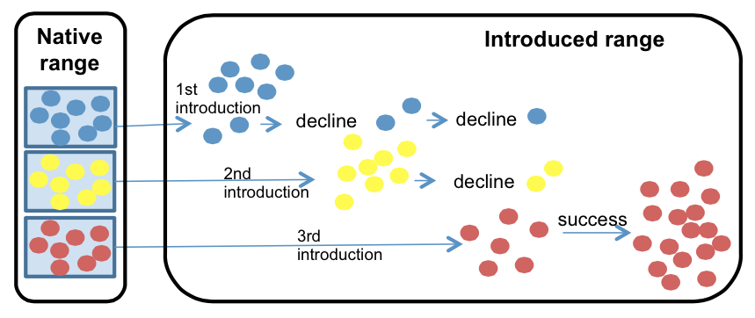
Identifying vectors and the native sources of introduced species
Prevent future invasions
Understand why a species succeeds or fails
Understand its future threat (adaptive capacity)
Rius et al. 2014 Biol. Inv.
Notes:
One important element of our understand of the invasion process is the identification of vectors and native sources of introduced species. This information can allow us to 1) prevent future invasions….

Slide 4
The greatest agency of all that spreads marine animals to new quarters of the world must be the business of oyster culture, a very ancient and world-wide craft. – Charles Elton (1958)

Slide 5
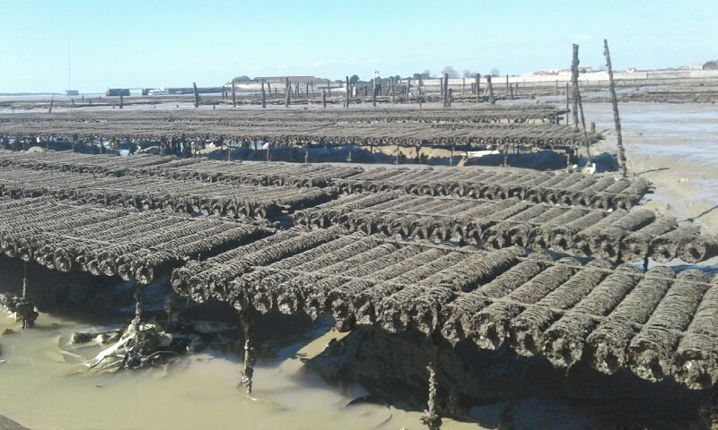
Crassostrea (Magallana) gigas Pacific cupped oyster
Among the most important aquacultural shellfish worldwide
C. gigas aquaculture
- $1.2 Billion per year
- 644,000 tons per year
Eric Pante

Slide 6
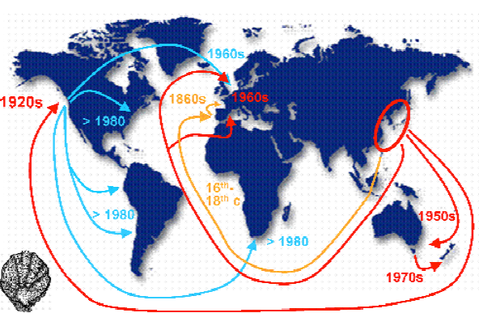
Crassostrea (Magallana) gigas Pacific cupped oyster
Among the most important aquacultural shellfish worldwide
Deliberately introduced to five continents for at least 150 years
Troost 2010

Slide 7
Crassostrea (Magallana) gigas Pacific cupped oyster
Among the most important aquacultural shellfish worldwide
Deliberately introduced to five continents for at least 150 years
An important vector for nonnative marine and estuarine species
Naylor et al., 2001, Ruiz et al. 2015, Ruesink et al. 2000

Slide 8
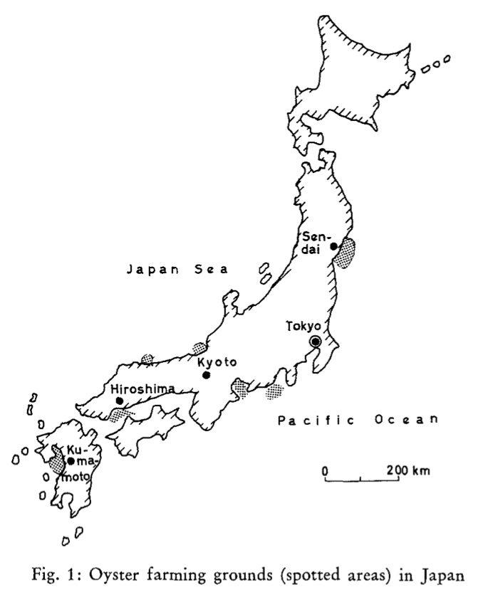
Three principal regions of industrial farming of Pacific oysters in Japan
Fuijya 1970

Slide 9
Three principal regions of industrial farming of Pacific oysters in Japan
Hokkaido
Miyagi
Hiroshima
(Seto inland Sea)
Fuijya 1970
Note: Kumamoto = C. sikamea

Slide 10
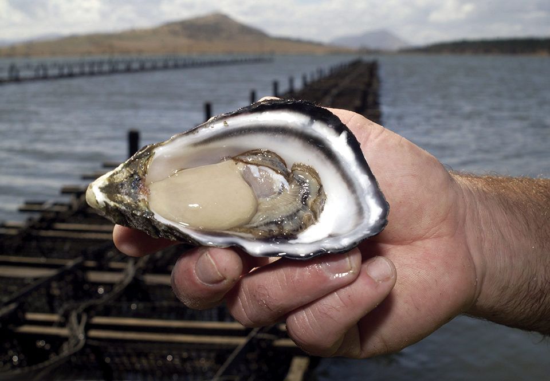
Genetic legacy of Pacific oyster introductions
Population genetic structure of native populations
The invasion history of non-native populations
Role of oyster invasions on species introductions
Bruce Miller, CSIRO

Slide 11
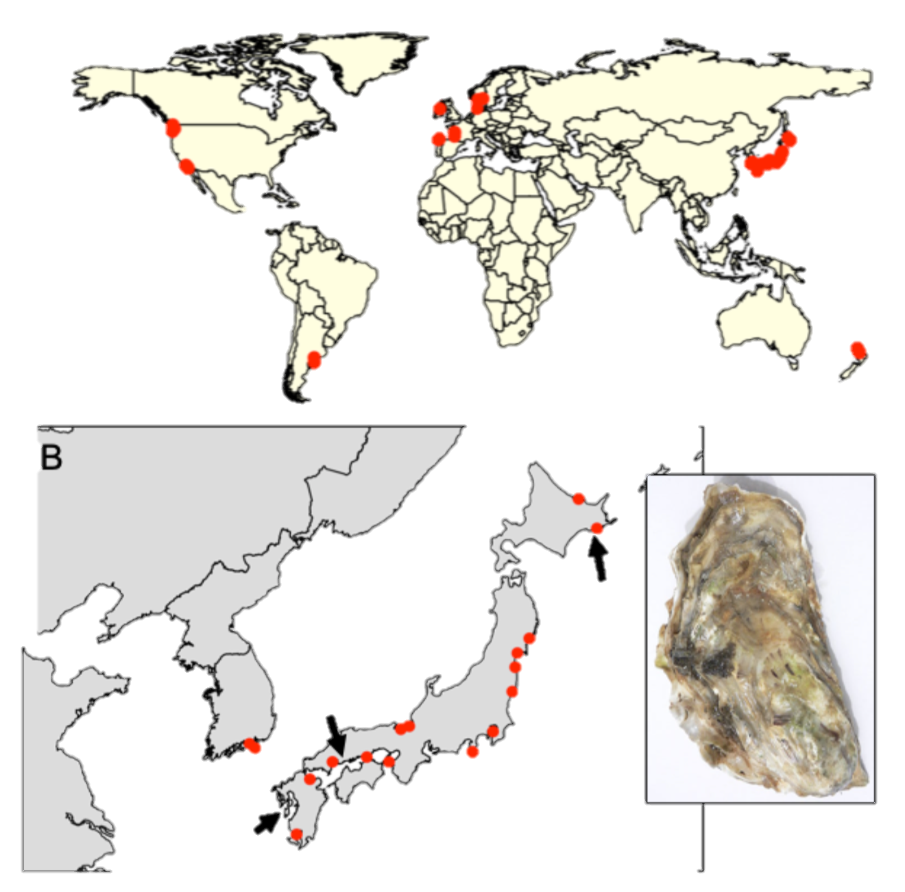
Sampling design
41 populations (n ~ 20)
20 native (Korea, Japan)
21 non-native (Europe, Western US, Chile, Argentina, NZ)
Feral populations (on rocks, jetties, reefs, etc..)
Genotype-by-sequencing
Dataset: 726 individuals and 7046 SNPs (no missing data and at HWE)
Hokkaido
Miyagi
Hiroshima
Kumamoto
Notes:
Kumamoto C. sikamea oyster

Slide 12
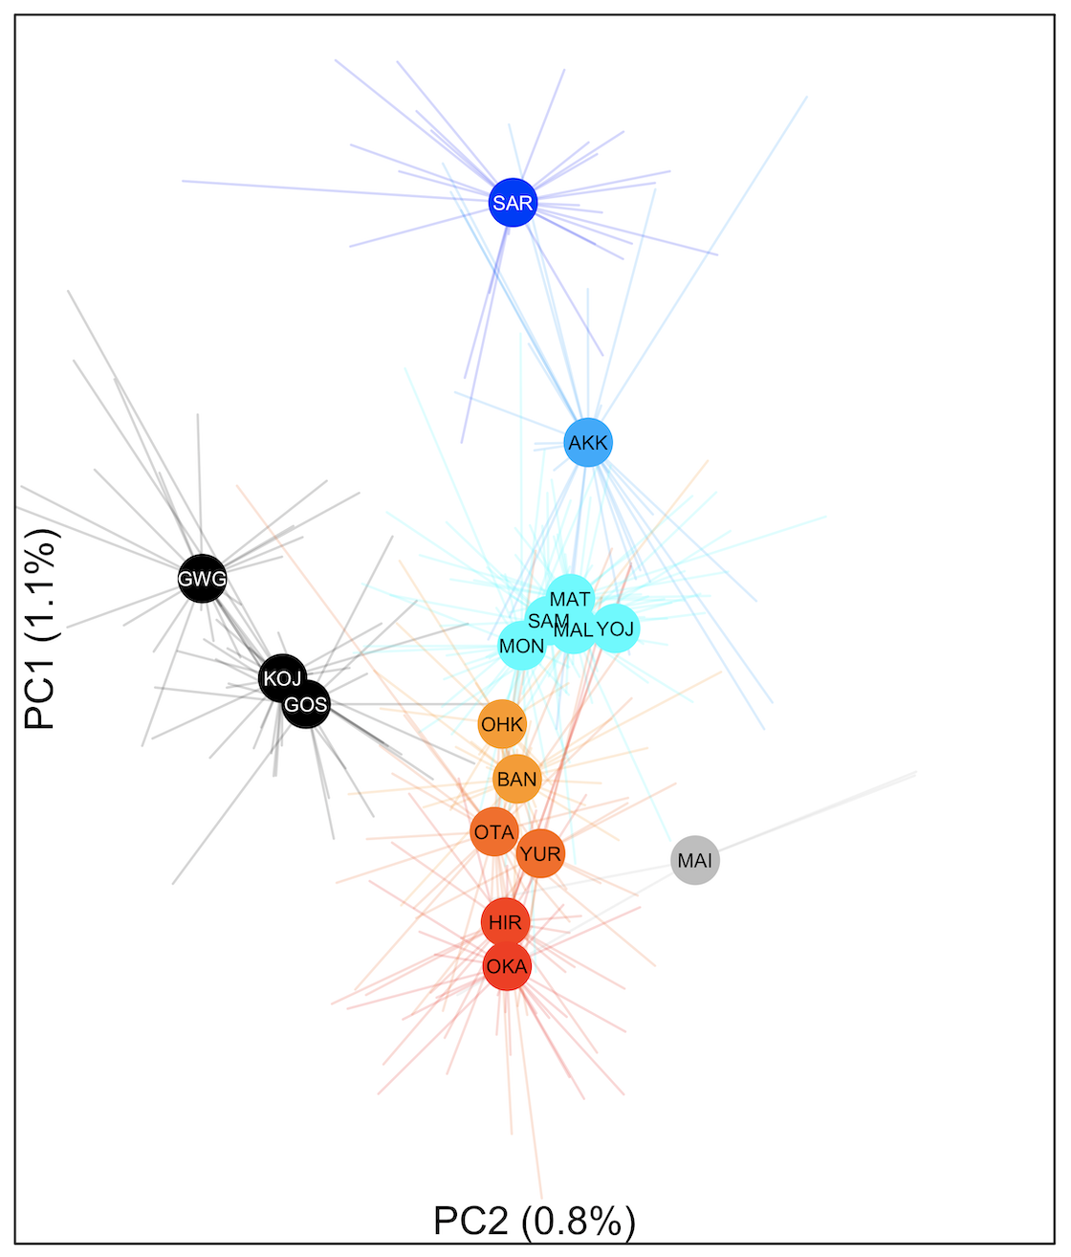
Genetic differentiation along latitude in Japan F_{ST} = 0 to 0.011
colors based on Genetic PC1

Slide 13
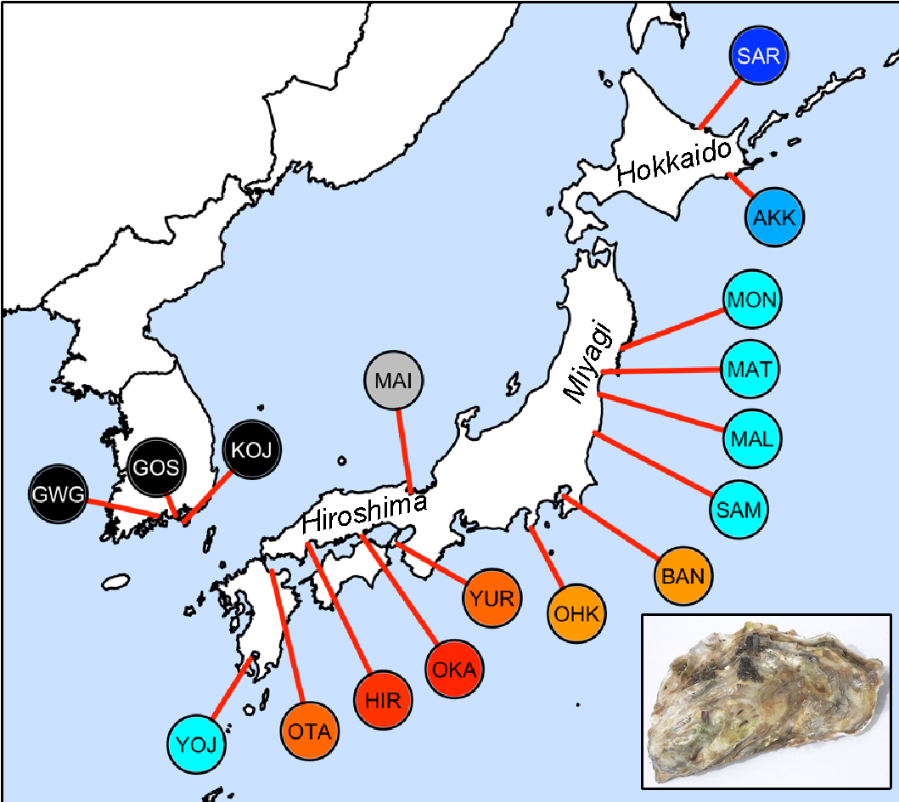
Genetic differentiation along latitude in Japan F_{ST} = 0 to 0.011
colors based on Genetic PC1
Hokkaido
Miyagi
Hiroshima / Seto Inland Sea
**

Slide 14
Genetic legacy of Pacific oyster introductions
Population genetic structure of native populations
The invasion history of non-native populations
Role of oyster invasions on species introductions
Bruce Miller, CSIRO

Slide 15
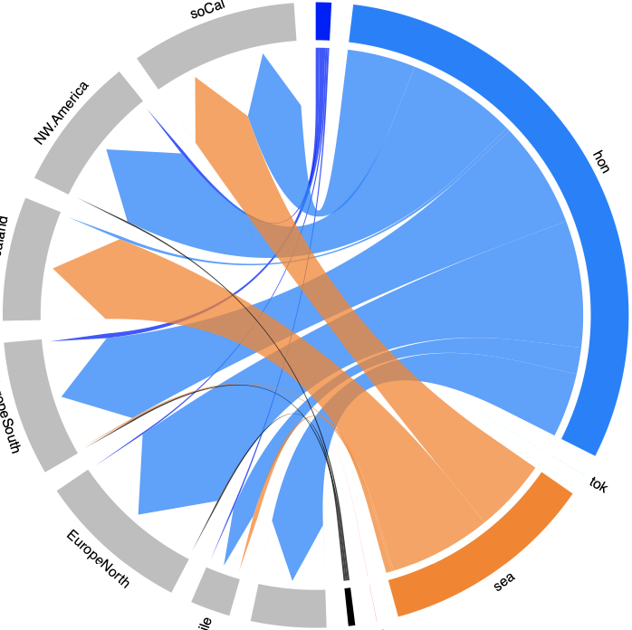
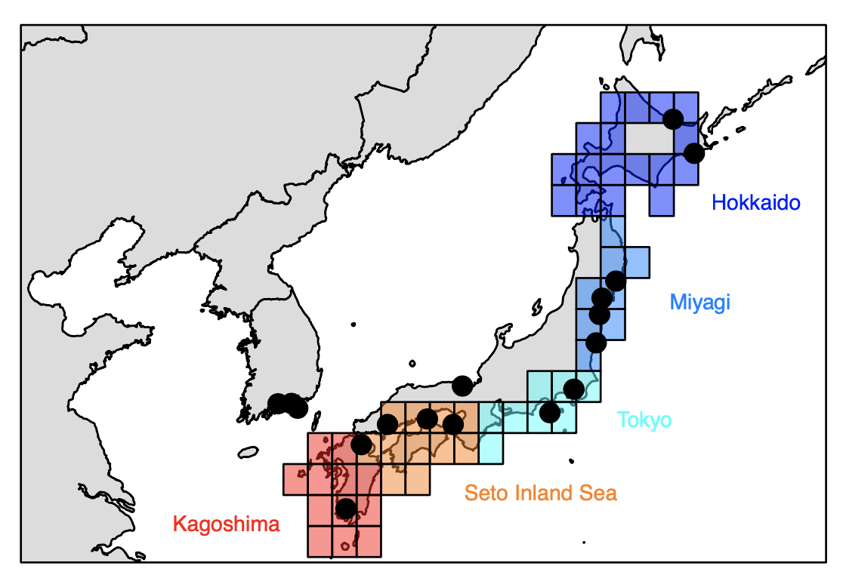
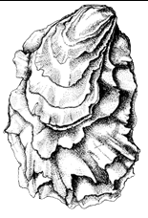
Pacific oyster invaders are from Seto Inland Sea and Miyagi
Miyagi
Tokyo
Seto Inland Sea
- Circlize plots summarize assignments from unsupervised machine learning (ML)
- Cross validation = 70%

Slide 16
Miyagi 🡺 Canada and WA Miyagi + Seto Inland Sea 🡺 California
North America
California
CA, WA
Miyagi
Tokyo
Seto Inland Sea

Slide 17
Seto Inland Sea 🡺 New Zealand
North America
California
CA, WA
Miyagi
New Zealand
Tokyo
Seto Inland Sea

Slide 18
Miyagi 🡺 Europe
North America
California
CA, WA
Miyagi
New Zealand
Sp, Fr
Europe
UK, De, G, Sw
Tokyo
Seto Inland Sea

Slide 19
Miyagi 🡺 Chile and Argentina
North America
California
CA, WA
Miyagi
New Zealand
Sp, Fr
Europe
UK, De, G, Sw
Tokyo
Seto Inland Sea
South America
Ch
Arg

Slide 20
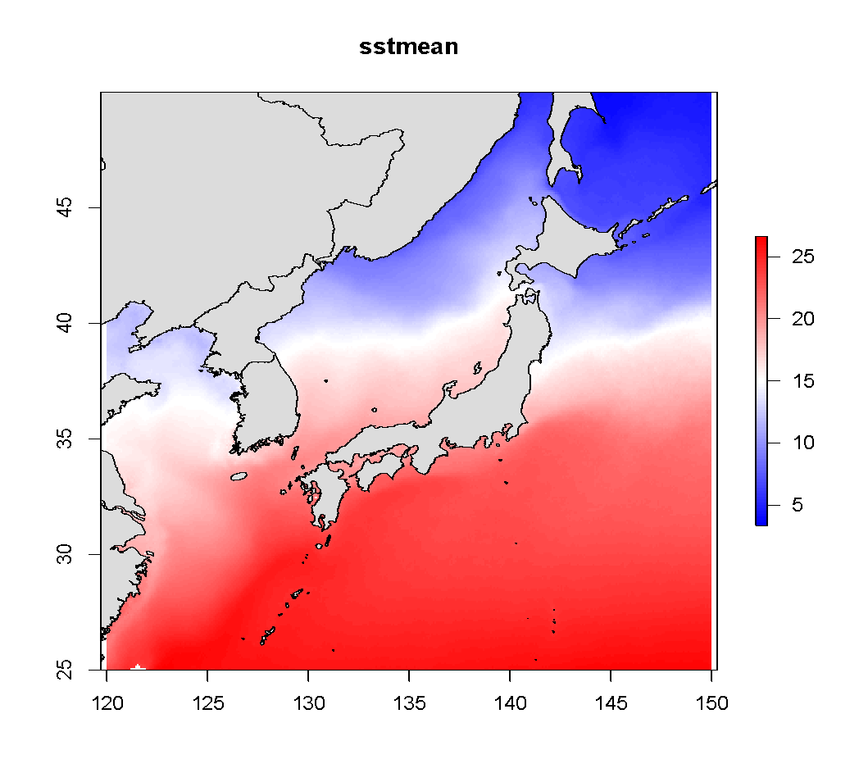
Genetic differentiation along latitude in Japan
colors based on Genetic PC1
Hokkaido
SST
Miyagi
Hiroshima / Seto Inland Sea

Slide 21
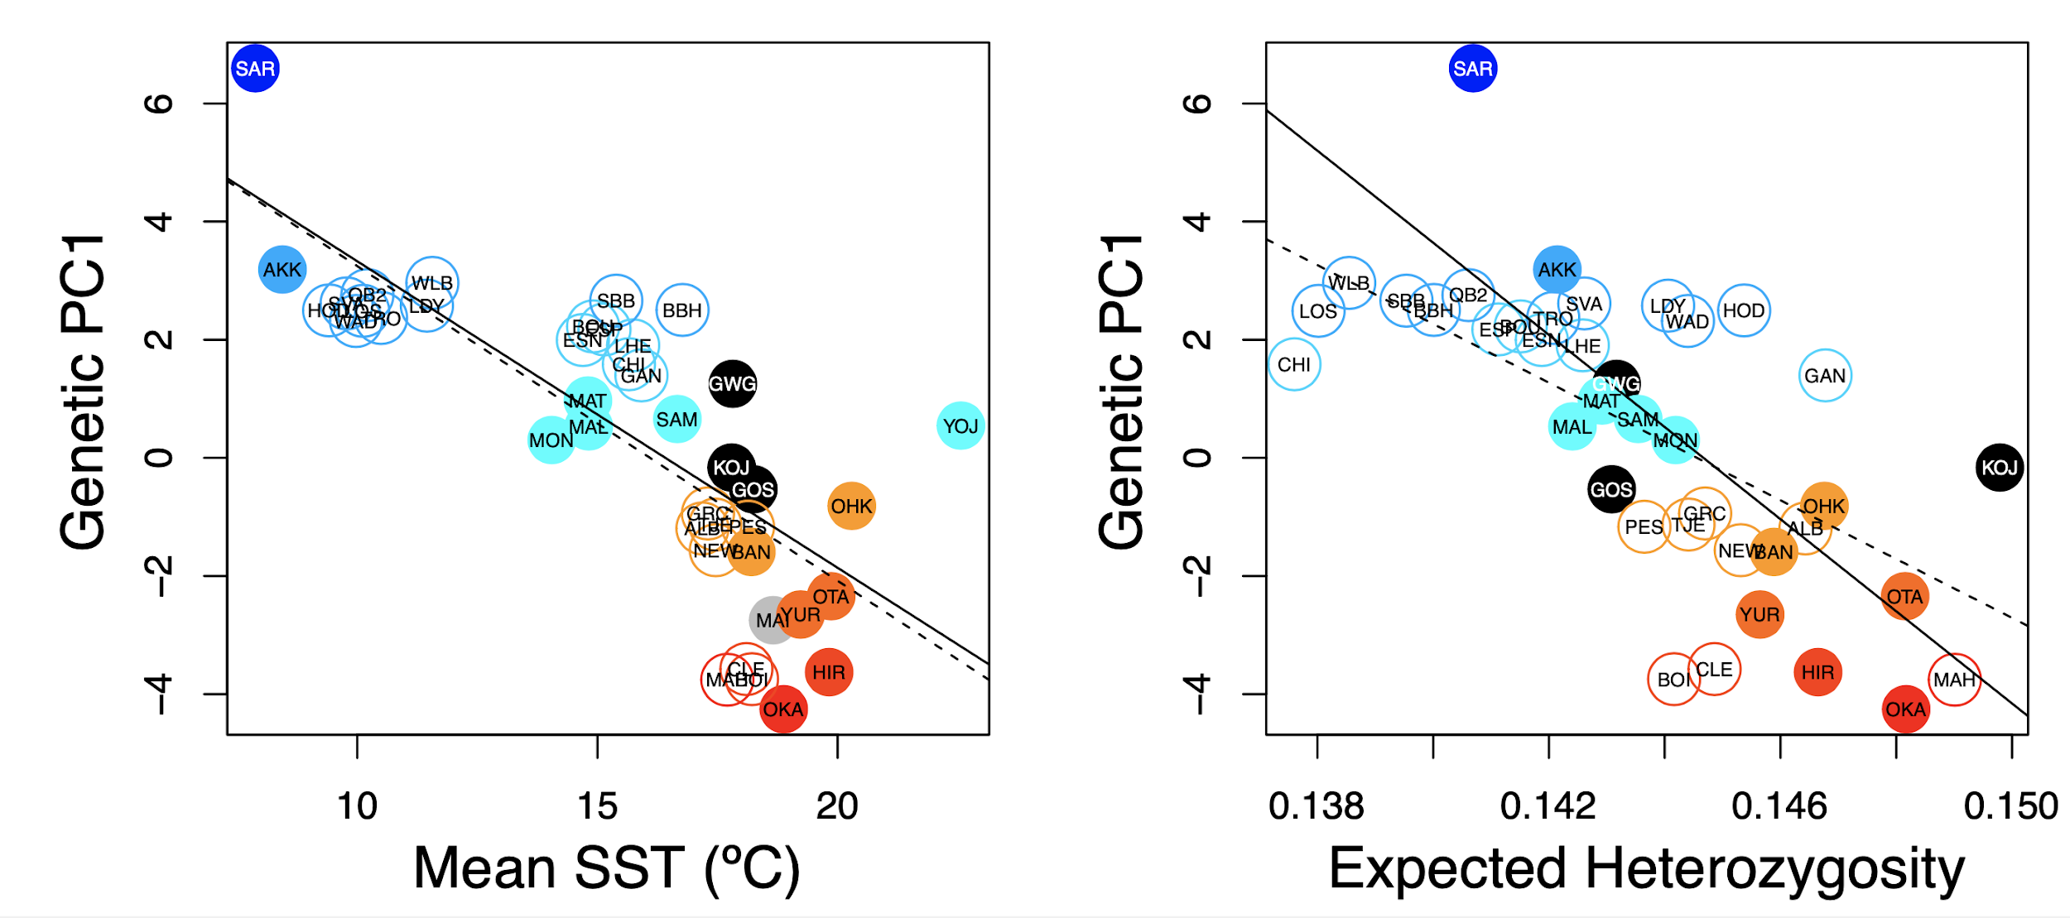
“Deliberate ecological fitting” of Pacific oysters
Native: r = -0.78; p< 0.001
Introduced: r = -0.74; p < 0.001
Ecological fitting reflects deliberate decisions by smart oyster biologists of appropriate genetic sources

Slide 22
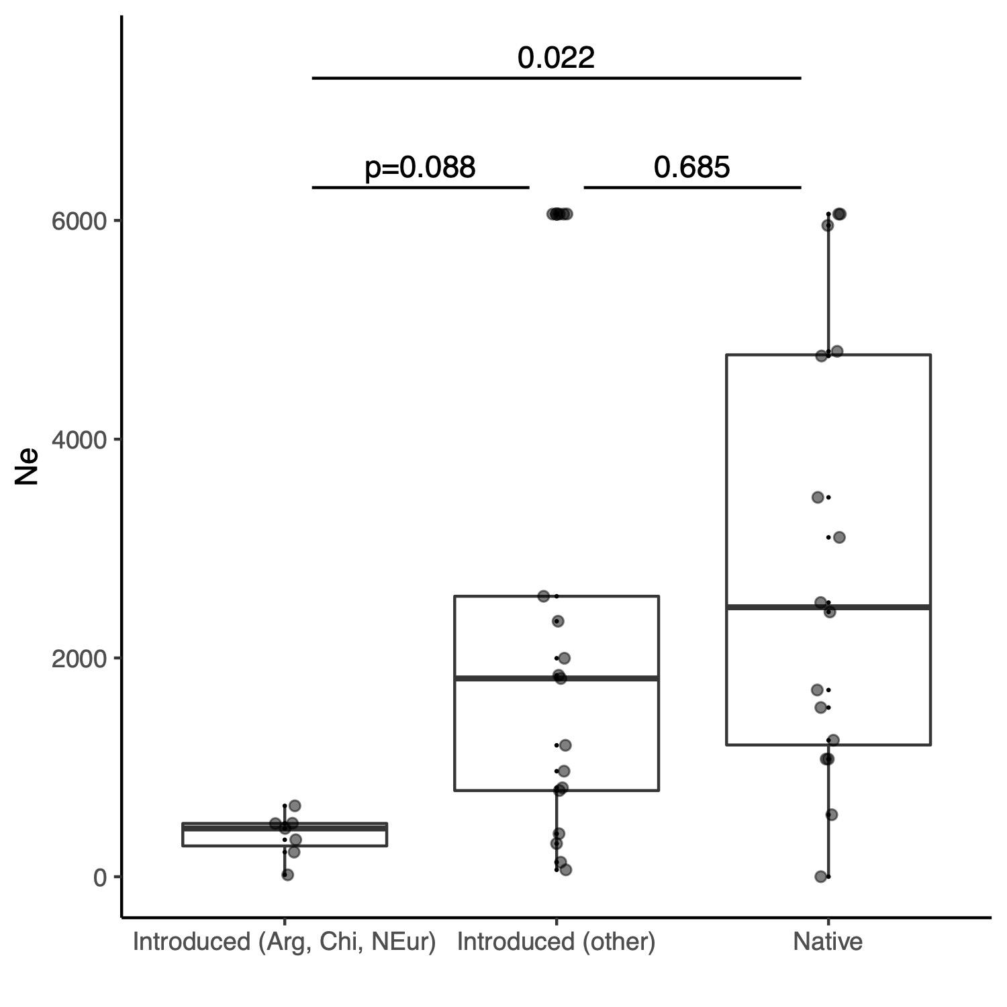
A genetic legacy of Pacific oyster introductions
6000
Populations with an aquacultural history (e.g., Northern Europe, Argentina) have lower effective population sizes (Ne)
4000
Ne
2000
0
Introduced
(Argentina, Chile, Northern Europe)
Introduced
(other)
Native
Ne estimated from linkage disequilibrium

Slide 23
Genetic legacy of Pacific oyster introductions
Population genetic structure of native populations
The invasion history of non-native populations
Role of oyster invasions on species introductions
Bruce Miller, CSIRO

Slide 24
The greatest agency of all that spreads marine animals to new quarters of the world must be the business of oyster culture, a very ancient and world-wide craft. – Charles Elton (1958)
But….we have not tested alternative hypotheses

Slide 25
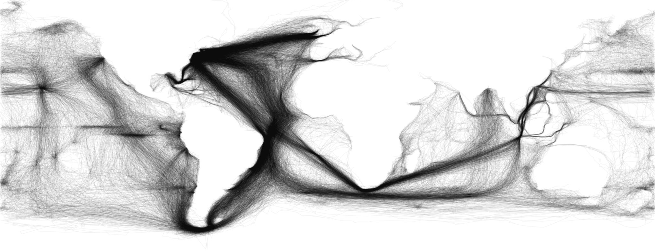
One alternative hypothesis = shipping (via fouling or ballast water)
ICOADS ship log data - https://icoads.noaa.gov
1950-2010
Notes:
ICOADS ship log data – used for climate research – ship logs
Full lat-long for every trip.
Drew regions on a map on the sources / destinations. Any ship that left and arrived within 28 days.
1950-2010

Slide 26
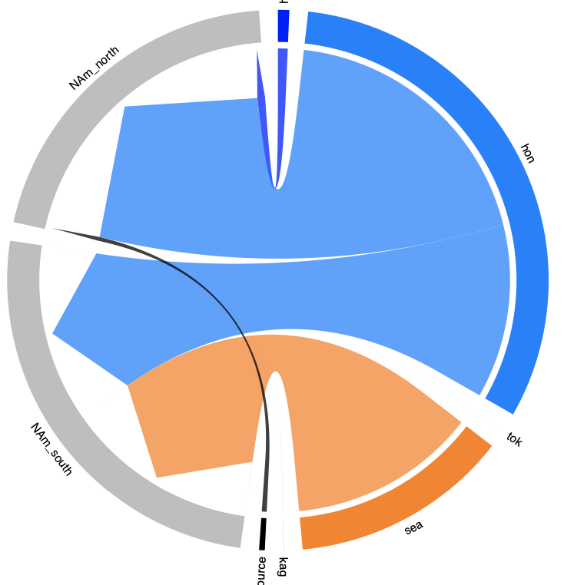
Vector = Oysters
Canada and
WA state
Miyagi
California
Seto Inland
Sea
Notes:
ICOADS ship log data – used for climate research – ship logs
Full lat-long for every trip.
Drew regions on a map on the sources / destinations. Any ship that left and arrived within 28 days.
1950-2010

Slide 27
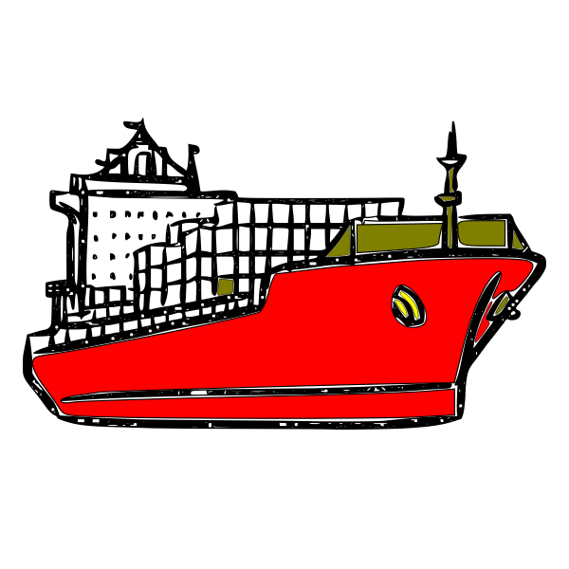
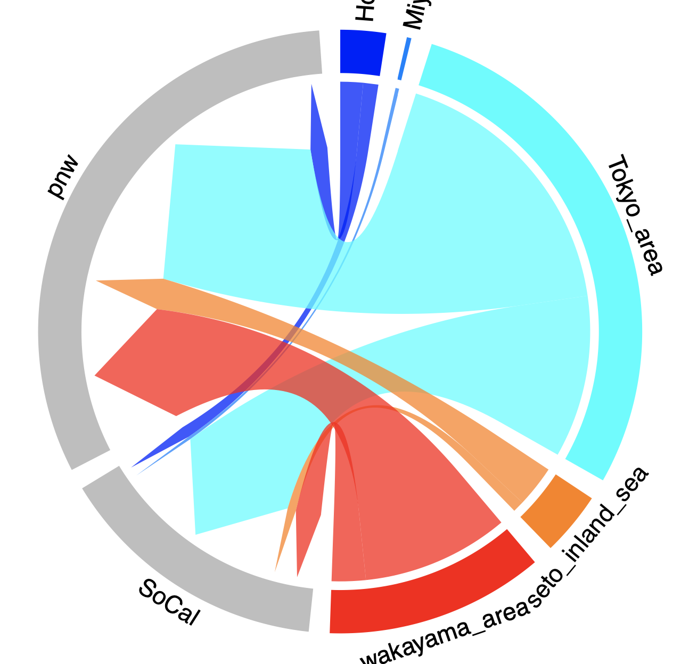
Vector = Oysters
Vector = Shipping
Hokkaido
Canada and
WA state
Miyagi
Canada and
WA state
Miyagi
Tokyo
California
Seto Inland
Sea
Seto Inland
Sea
California
Kagoshima
Notes:
ICOADS ship log data – used for climate research – ship logs
Full lat-long for every trip.
Drew regions on a map on the sources / destinations. Any ship that left and arrived within 28 days.
1950-2010

Slide 28
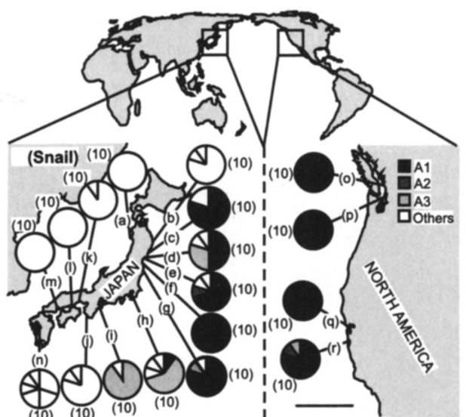
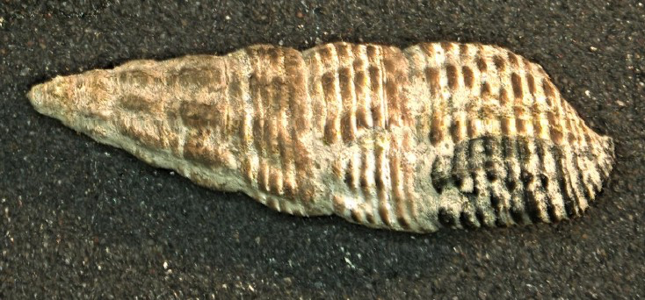
Approximate Bayesian Computation (ABC) evaluates alternative invasion hypotheses
Battillaria attramentaria
Miura et al. 2005 PNAS

Slide 29
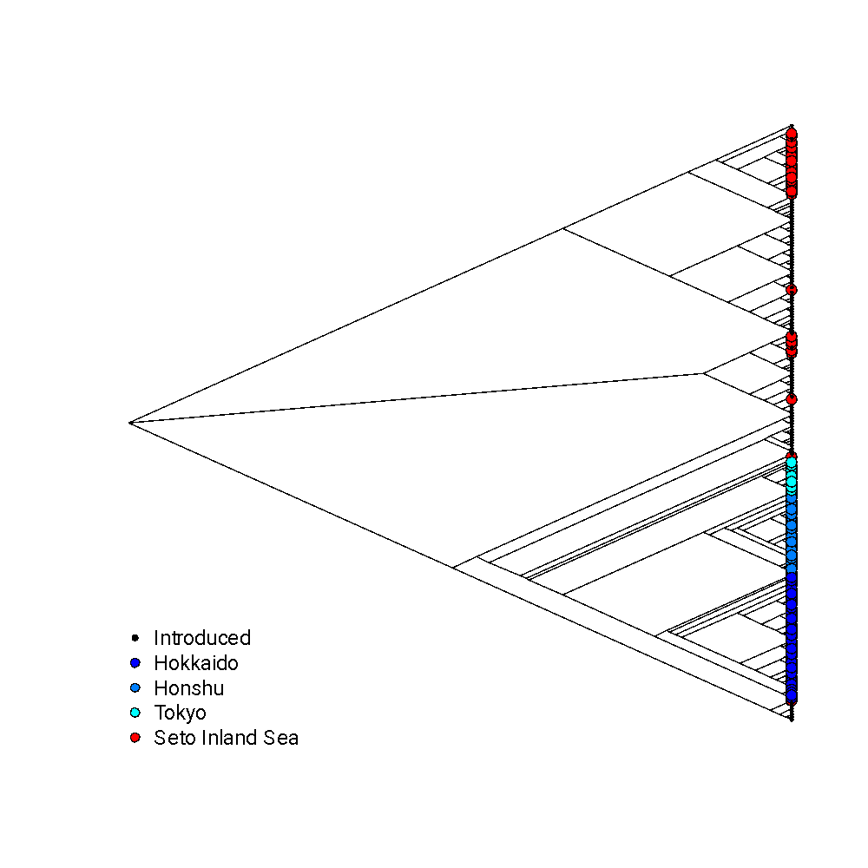
Approximate Bayesian Computation (ABC) evaluates alternative invasion hypotheses
• 200K FastSimCoal simulations per model
• We vary Time since coalescent, Mutation rate, Effective population size (Ne)
• 4 migration models
• Response: diversity within and among populations

Slide 30
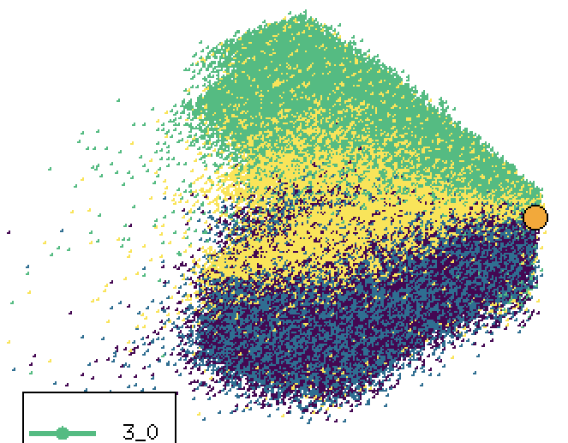
Approximate Bayesian Computation (ABC) evaluates alternative invasion hypotheses
Battillaria attramentaria
Oyster vector
model 1
Miura et al. 2005 PNAS
model 2
Shipping vector
PC2
30 days
60 days
Principal Components Analysis (PCA) of population genetics statistics
PC1
Notes:
Principal component of genotypes from 4 models of invasion from Batillaria. Coalescent models
1 and 2 are shipping (30 d vs 60 d at sea)
3 and 4 are gigas (qualitative and quantitative assessment of vectors)
Model 4 and 1 is what we show later.
simCoal
Bayes Factor (posterior probabilities of the closest models to the actual dataset – 99% of the models were thrown out. Only kept the ones cloes ~1% of dataset)

Slide 31
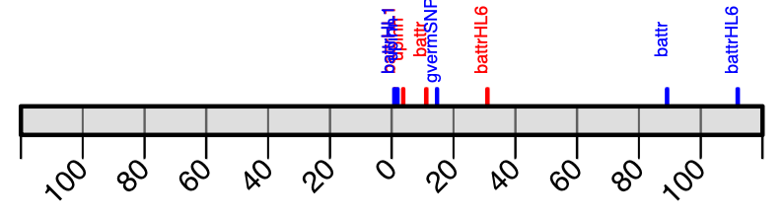
Approximate Bayesian Computation (ABC) evaluates alternative invasion hypotheses
Vector = shipping
Vector = oyster
Strength of support (Bayes Factor)
Notes:
https://freesvg.org/1488449982

Slide 32
Batillaria attramentaria
Oyster vs 30 days shipping
Oyster vs 60 days shipping
Vector = shipping
Vector = oyster
Strength of support (Bayes Factor)

Slide 33
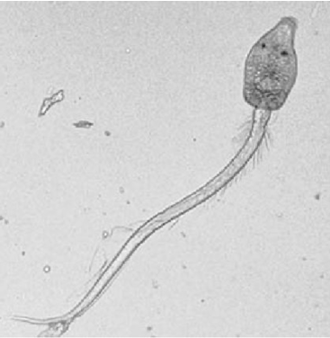
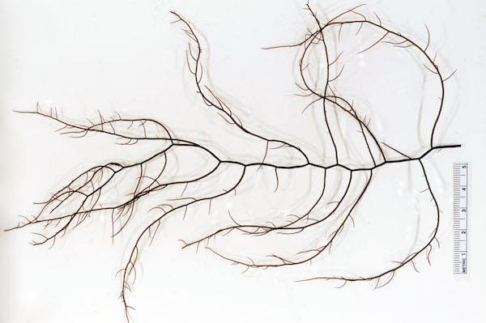
Cercaria batillaria HL6
Batillaria attramentaria
Gracilaria
vermiculophylla
Oysters are 10 – 4000X more likely than a shipping vector
BF = 4340
Vector = shipping
Vector = oyster
Strength of support (Bayes Factor)

Slide 34
Cercaria batillaria HL1
Undaria pinnatifida
Neither oysters nor shipping are more likely to be a vector
Vector = shipping
Vector = oyster
Strength of support (Bayes Factor)

Slide 35
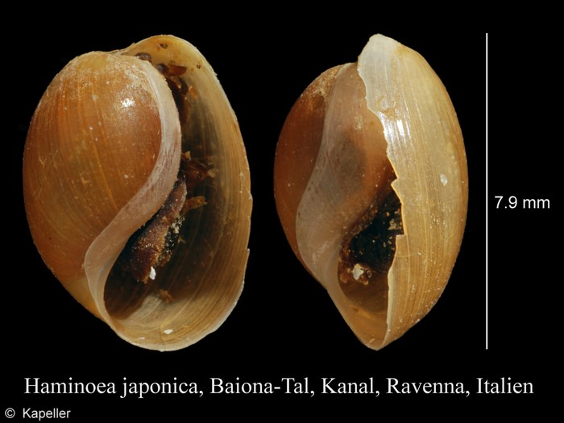
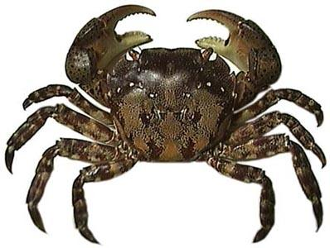
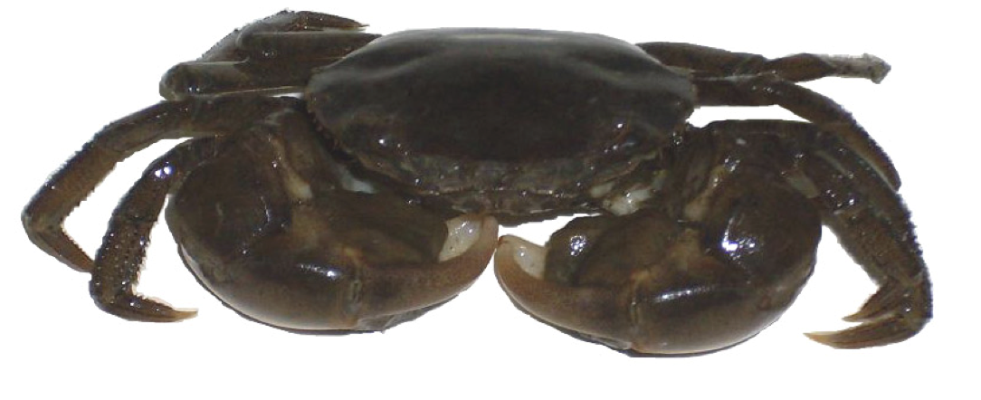
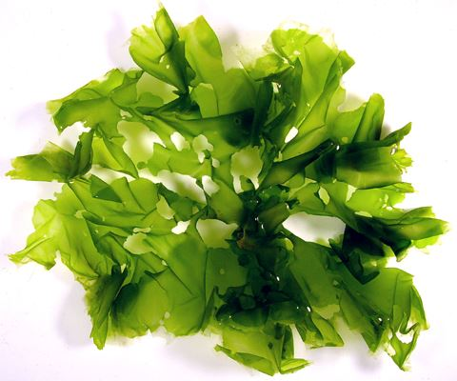
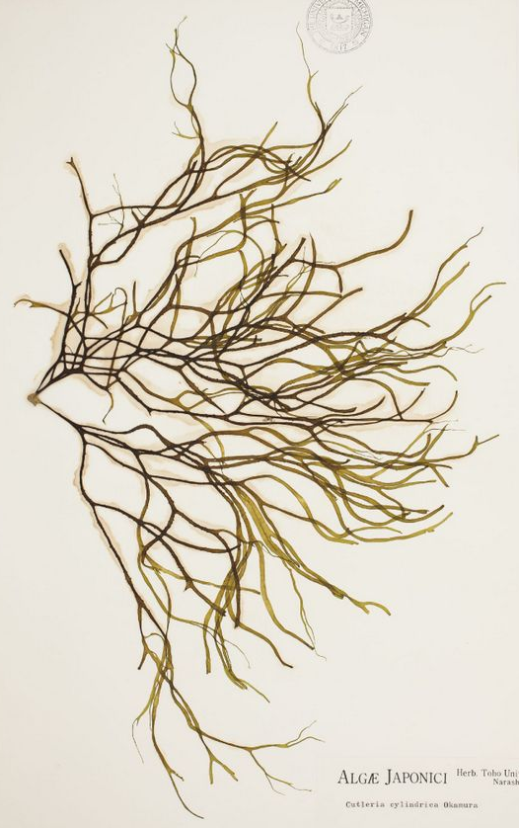
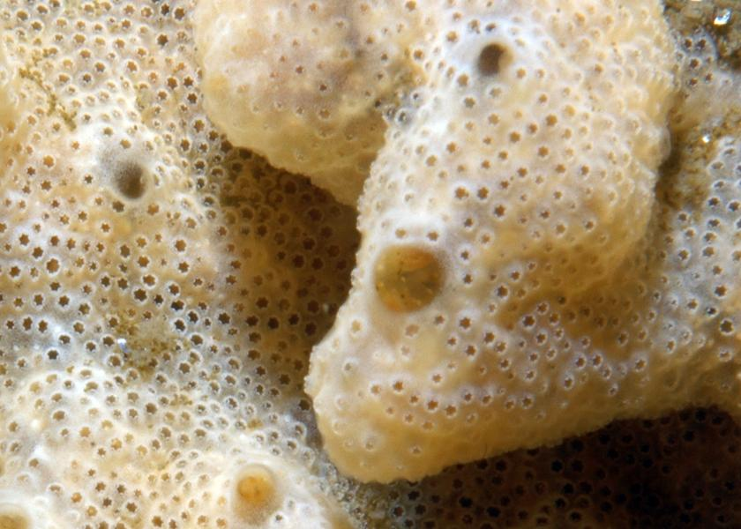
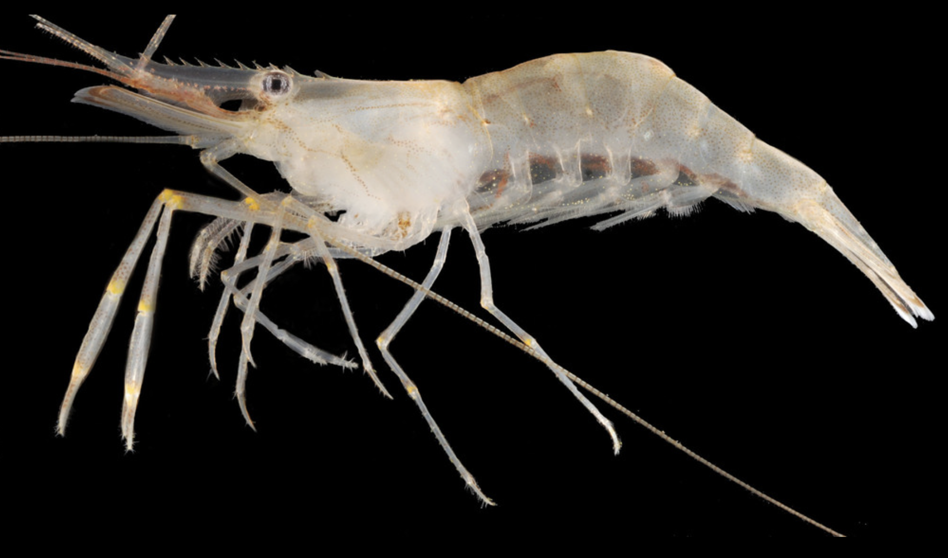
Criteria for inclusion
Genetic data are publicly available
2+ regions in Japan
Western NA, Europe or both
Hemigrapsus takanoi
Haminoea japonica
Hemigrapsus sanguineus
Gracilaria
vermiculophylla
Ulva pertusa
Undaria
pinnatifida
Battillaria attramentaria
Didemnum vexillum
Mutimo
cylindricus
Palaemon macrodactylus
Notes:
Algae (4); Crustaceans (3); gastropods (2); trematodes (2); tunicate.
Putative vectors (oysters, ballast water, birds, aquarists)
Life history from brooders to pelagic dispersers

Slide 36
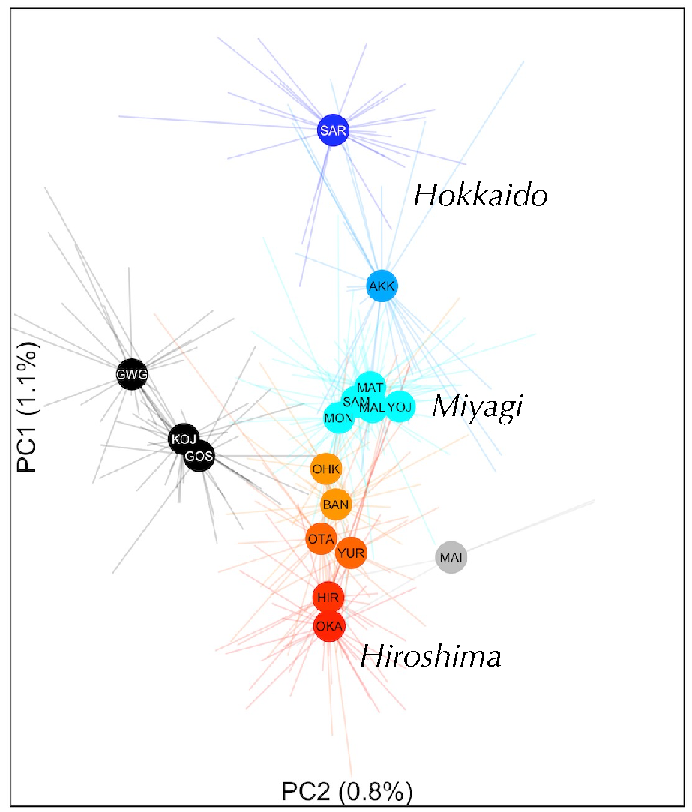
Conclusions
There is weak (F_{ST} < 1%) but significant genetic differentiation in the native range

Slide 37
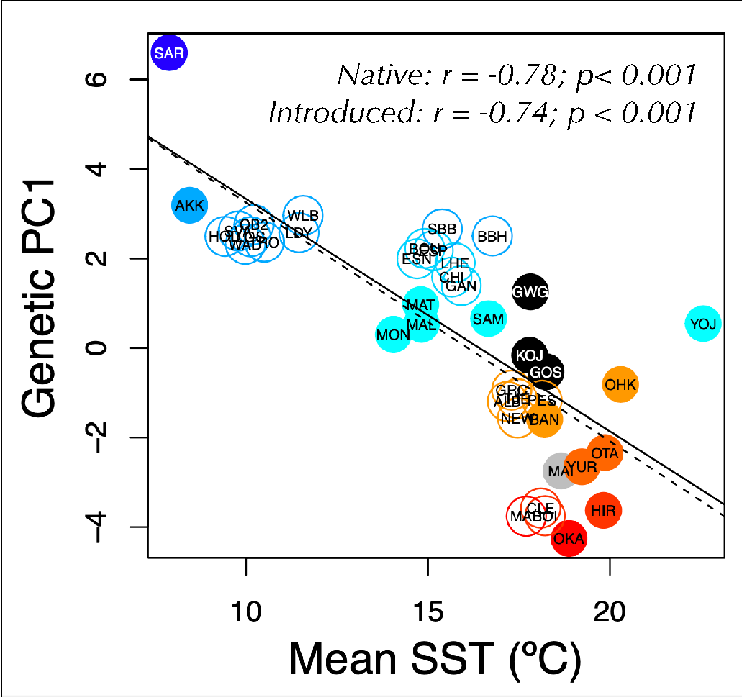
Conclusions
There is weak (F_{ST} < 1%) but significant genetic differentiation in the native range
Transport of locally-adapted genetic stocks by oyster biologists yielded “deliberate” ecological fitting in the non-native range.

Slide 38
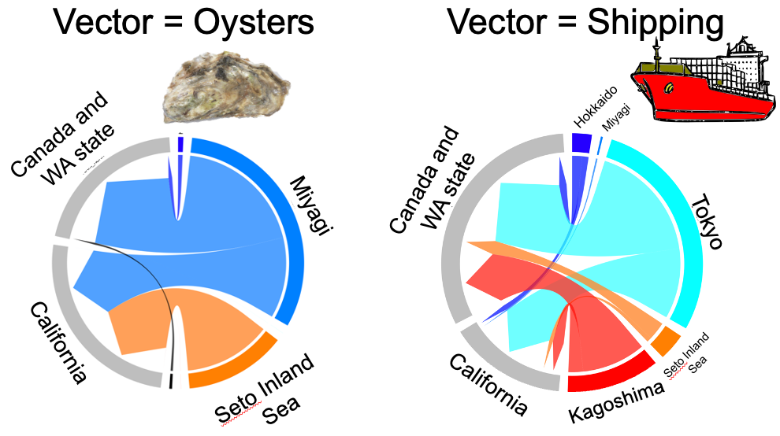
Conclusions
There is weak (F_{ST} < 1%) but significant genetic differentiation in the native range
Transport of locally-adapted genetic stocks by oyster biologists yielded “deliberate” ecological fitting in the non-native range.
We now have a mechanism to delineate oyster vs other vectors.

Slide 39

Acknowledgements
Argentina | Evangelina Schwindt
Chile | Martin Thiel, Jim Carlton
Denmark | Asa Strand
France | Eric Pante
Ireland | Asa Strand, Judith Kochmann
Japan | Takefumi Yorisue, Masahiro Nakaoka, Mits Kanaya, Masahiro Hori, Gen Kanaya, Ryuta Terada, Hikaru Endo
Korea | Kun-Seop Lee
New Zealand | Richard Taylor
Norway | Asa Strand
USA | Jennifer Ruesink, Hilary Heyford, Danielle Zacherl, Jeff Crooks
Spain | Lucia Couceiro
Sweden | Asa Strand, Judith Kochmann
OCE-1924599
Also Lauren Lees, Hannah Rothkopf, Hannah Miller, Dallas Crowder, Ryan Carnegie, Osamu Miura

Slide 41
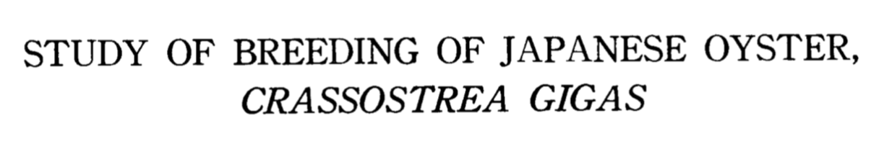
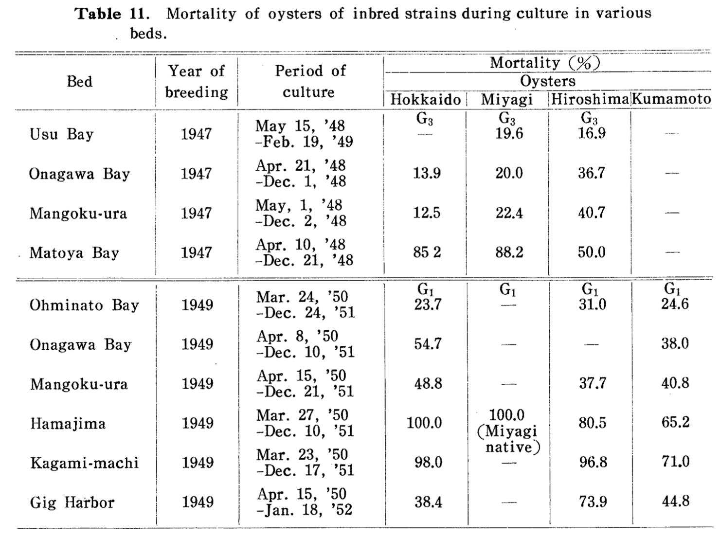
Oyster biologists identified “appropriate” genetic sources via transplant experiments
Imai and Sakai 1961
Puget Sound WA
(47ºN)
Northern Japan
(44ºN)
Southern Japan
(33ºN)

Slide 42
A genetic legacy of Pacific oyster introductions
Native: r = -0.76; p = 0.001
Introduced: r = -0.63; p < 0.001
Introduced populations maintain similar heterozygosity as their genetic source

